Slide 1
Meta LM-Infinite
Lambda-Masking & De-Cluttered Memory

Slide 2
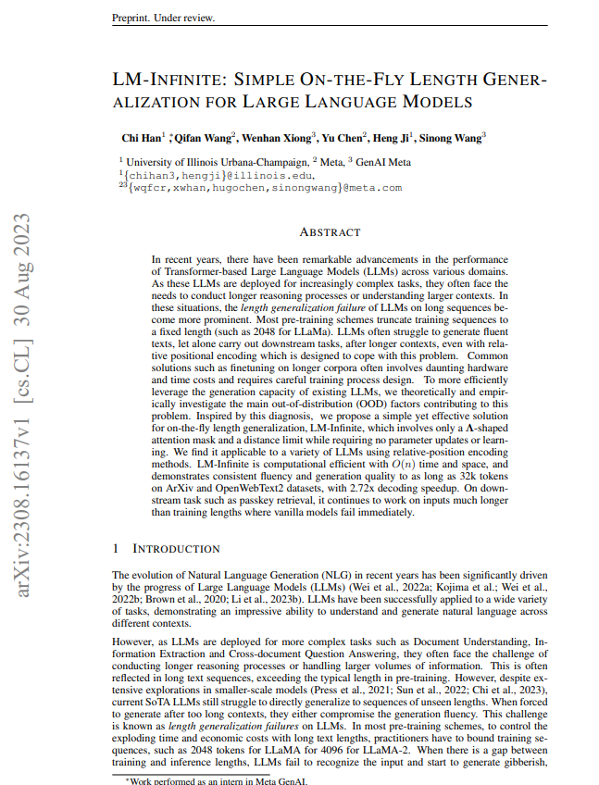
The Paper
Preprint, still under review
Proposes two primary innovations
A Λ-shaped attention mask to constrain the number of tokens attended to. This addresses the issue of high entropy/diluted attention when attending to too many tokens.
Bounding the relative distances during attention to a fixed value. This prevents exploding attention logits due to unseen long distances.
Problems solved
Exploding logits on sequences longer than training data
“Plug-and-play” solution on multiple Open Source LLMs
Results include
Better performance such as passkey retrieval on long sequences
Works on sequences far longer than training data

Slide 3
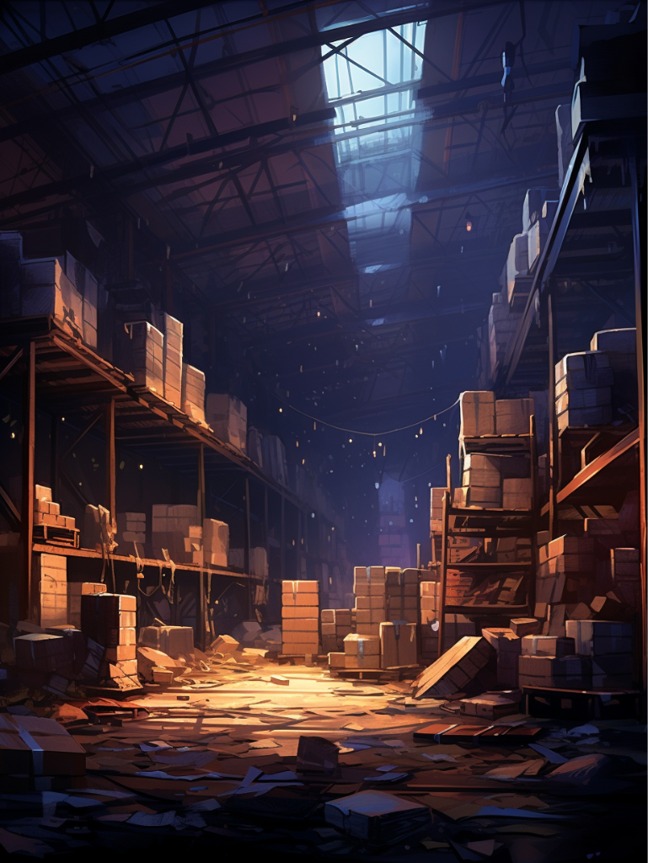
Cluttered Warehouse
Large context windows are like enormous warehouses
Lots and lots of tokens to keep track of
Mathematical complexity of this volume becomes untenable
Similar to human working memory
Cluttered and overloaded working memory impairs reasoning
Constrained, cleaner working memory yields better performance
Basically forces LLM to do garbage collection

Slide 4
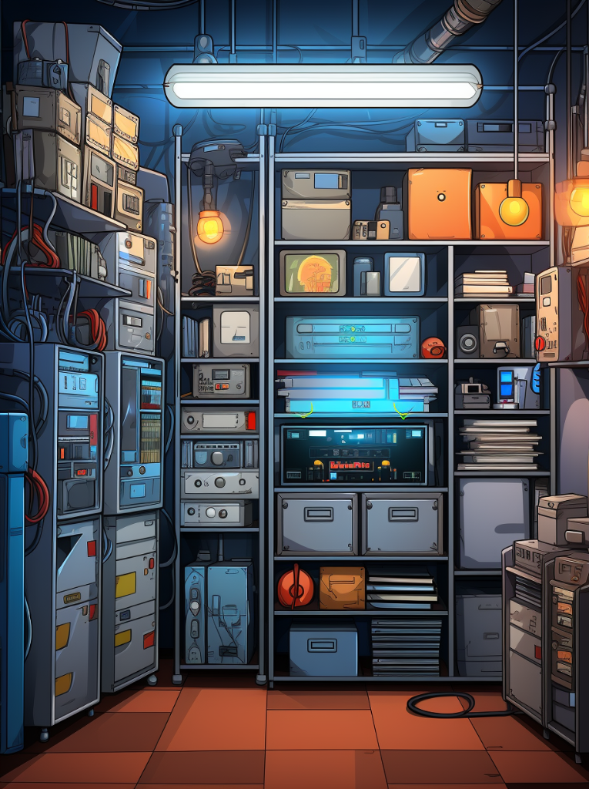
Tidy Storage Closet
Less to keep track of
Mathematically simpler
Which one would you rather be responsible for?
Prevents dilution and degeneration
Pretty much impossible to get lost in this cleaner space

Slide 5

Easy Tweaks
Tested on several open source LLMs
LLaMA, GPT-J, and MPT-7B
Utilizes existing mechanisms
Just changes the algorithm a little bit
Analogous to garbage collection
Frees up memory (attention) by masking unused tokens
Forces prioritization, constranes size of memory
Not a perfect analogy, but sensible enough
The Λ-mask privileges retaining the newer local context while masking away older tokens
Garbage collectors prioritize collecting older unreferenced data first
Both aim to create free space and reduce clutter in memory without losing critical information

Slide 6

So what?
Might ultimately change the way we interact with LLMs
Better attention mechanisms
Bigger windows
Combine with One Billion Tokens
Might invalidate vector search
Examples
Writing Fiction: Keep track of millions of words across many books
Scientific Research: Survey and correlate thousands of papers at once
Enterprise Business: Search thousands of company documents simultaneously
TLDR
Efficient working memory akin to garbage collection
Better performance, especially on long contexts

Slide 7
Thank you

